Slide 1
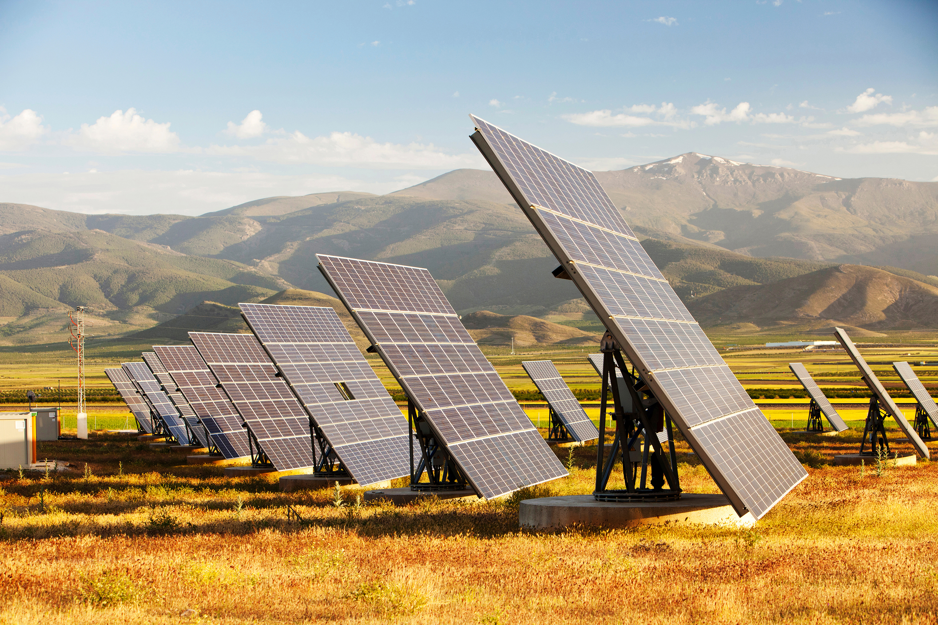

FIRST SOLAR (NASDAQ: FSLR)
Recommendation: LONG
Current Price: 245.84 (Closing Price on 20.11.2025)
Blended Target Price: 359.12 (41.94%)
Team Members: Alex Brown, Fleur Brinkmann, Junhao He, Joe Xu, Michael Kerins, Yifei Wang
IC: Mias Erni
November 22nd, 2025
1

Slide 2

Pitch Summary
Long First Solar | Policy-Protected Market Leader With Multi-Year Margin Expansion Still Underpriced
We propose a long position in First Solar (FSLR), supported by structural policy tailwinds, a durable technology moat, and multi-year margin expansion
First Solar is the leading U.S.-based solar manufacturer with a fully domestic, FEOC-compliant supply chain and differentiated CdTe thin-film technology
Despite strong historic share performance, we believe key catalysts remain underpriced, providing further upside potential from current share price of $245.9 (closing price 20.11.2025) to $359.1 by 2028 in our base case, representing a 46.13% upside
Narrative
Valuation and Price Target
Thesis 1
Undisputed Domestic Leader
Only large-scale US module manufacturer with fully compliant CdTe tech, insulated from polysilicon swings and China overcapacity
ü
1
Analysts project 22.8%–42.4% long-term growth (mean 32.6%) and a mean FY2025 price target of $274 by Q1 26
FSLR trades at an earnings multiple that does not reflect its protected U.S. market position or multi-year margin expansion potential
With Series 7 ramp, 45X credit capture, and a >$20bn contracted backlog, earnings visibility is strong
Our valuation framework supports continued upside as regulatory catalysts crystallize, and the efficiency roadmap delivers margin accretion
Thesis 2
Structural Regulatory Moat
FEOC¹⁾, AD/CVD²⁾, Section 232, and IRA³⁾ 45X credits all tighten the gate on imports while boosting FSLR’s unit economics. U.S. capacity is sold out through 2028
2
Thesis 3
Premium Margins + Visibility
ASPs are firming, bookings accelerating (record 2.1 GW month), and a multi-year backlog is expanding, while gross margins trend toward 50–55% as U.S. finishing capacity ramps and 45X credits scale
Current Valuation vs. 2028E Base Case ($)
3
$359.1
base case
+46.1%
Catalysts
Policy + Production Catalysts Ahead
Section 232 outcomes, FEOC restrictions, and a 45–50% module ramp through 2028 collectively reinforce higher U.S. ASPs, strengthen pricing power, and accelerate volume growth
$245.9 closing share price
20.11.2025
Notes:
Bear case, make clear 3 thesis to support upside
Micheal: less financials
Yifei: don’t ask question
Micheal: Slide 5 a bit to long
Yifey: Less esg -> highlight also vertical integration + domestic advantage
Fleur: Last sentence referencing to graph not necessary
Thesis 3: like structure 1st 2nd 3rd -> more concise
Valuation: shorter case description
Sensitivity: base case sensitivity → can be more concise
Catalysts: more concise risk/mitigants → catalysts very importance

Slide 3






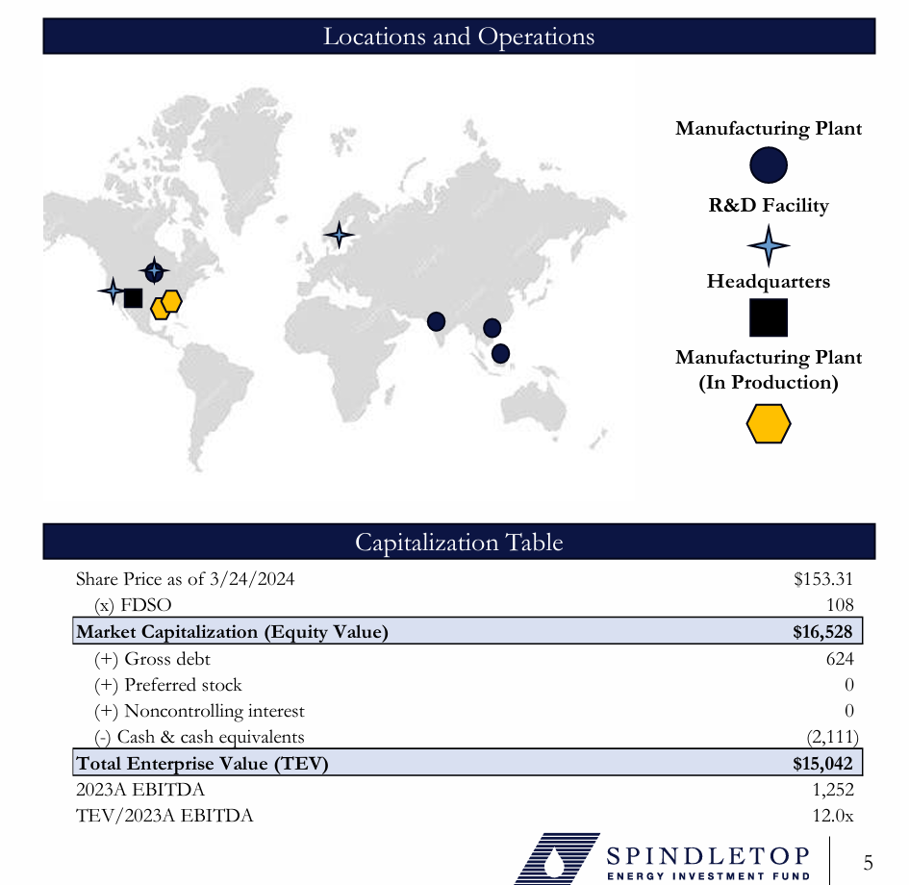
To Dos
Edit yellow parts
Find more suitable logos in pptx icon library (insert -> icons)
Add sources
Highlight important things bold (dark blue)
Clarify abbreviations in footnotes with 1), especially for CdTE and C-SI
Include Investment activity (acquisition of Evolar)
Factcheck information if I interpreted your content correctly
Company Overview
First Solar | A Vertically-Integrated U.S. Manufacturer With Long-Term Contracted Revenue
Business Snapshot
Manufacturing Footprint & Supply Chain
General Information: First Solar, founded in 1999 and headquartered in Tempe, AZ, is a manufacturer of solar photovoltaic panels, modules, and systems for utility-scale development projects. The company employs 8,100 people and is recognized as the world's largest thin-film solar module manufacturer, utilizing cadmium telluride technology.
Deal History & Financials: First Solar reported $1.59B in quarterly revenue (79.67% growth YoY) and $589.22M Normalized EBITDA as of September 30, 2025. The company olcompleted a secondary transaction on September 21, 2020, where Mr. Lukas T. Walton sd an 8.2% stake for $592.46M. First Solar raised $400M in its initial public offering on November 17, 2006, selling 20,000,000 shares on NASDAQ under the ticker FSLR.
Investors & Team: First Solar is led by Mark Widmar as CEO. Key executives include Alex Bradley (CFO), Markus Gloeckler (CTO), and Caroline Stockdale (Chief People and Communications Officer). Former investor includes True North Partners.
Investment Activity: First Solar has recently acquired Evolar and made investments in solar technology companies like CubicPV and Peloton Output Park, focusing on enhancing its manufacturing capabilities and solar panel technology.
Leading US solar PV manufacturer founded in 1999. The world’s largest CdTe solar module manufacturer with 8,100+ employees. 2006 IPO raised $400M.
Utility-scale focus. Multi-year contracts with major developers (e.g., Ørsted).
Strong commercial position with ~32% U.S. share and multi-year visibility from a 54.5 GW backlog and 79.2 GW pipeline
Strong financial trajectory with $1.59B quarterly revenue (~80% YoY) and $589M normalized EBITDA (Q3’25). Public since 2006 (NASDAQ: FSLR); notable transaction includes the 2020 secondary sale of an 8.2% stake for ~$592M
Leadership: CEO Mark Widmar has been with the company 13 years. Other key executives: Alex Braddley (CFO) and Markus Gloeckler (CTO), and Caroline Stockdale (Chief People and Communications Officer)
Manufacturing Facilities in Ohio, Alabama, Malaysia, India, Vietnam
Fully vertically integrated 4-hour process (compared to multi-day and multi-site c-Si manufacturing)
Two new facilities under construction in the US (additional ~7 GW), bringing total 2026 US capacity to ~11 GW and ~25 GW globally
Considerably less supply chain risk than c-Si modules. Minor supply chain risk: 75% of global Tellurium from China
Innovation
Dedicated R&D Innovation Center ($270M investment)
Company forecast: 28% cell efficiency by 2030 (currently 22%)
Investigating Bifacial modules and Tandem Products
Larger Form Factor: Rapid Installation and reduced BOS costs
Headquarters (Tempe, AZ)
Environmental Positioning
Reusable delivery packaging and Recycling Program
Lowest carbon and water footprints
90% material recovery
Semi-conductor material reuseable 41 times
R&D Facility
US Solar Market Share
~32% in Q2 2025
Revenues ($m)
Manufacturing Plant
3,905m (22% YoY)
Manufacturing Plant (in production)
9%
202m (1750% YoY)
2025 Sales Guidance
$4.95B - $5.20B (18% - 24% YoY)
34m (-50% YoY)
2024 Revenues
Country | 2024 ($ in Millions) | YoY Change (%)
United States | 3,904.8 | 22
India | 201.7 | 1750
France | 34.4 | (50)
Other | 65.4 | 26
Total | 4,206.3
Other: 65m (26% YoY)
Technology, Innovation & ESG Advantage
Financial Profile & Geographic Mix
Innovation pipeline: $270m R&D Innovation Center, 28% cell efficiency target by 2030 (from ~22% today)
Investigating Bifacial, Tandem, and larger Form-Factor modules reducing BOS costs. 2023 acquisition of Perovskite Specialist Evolar
($ in millions) | 20/11/2025
Share Price | 245.84
NOSH (M) | 107.3
Market Cap. (Equity Value) | 26,380.6
(+) Gross debt | 891.92
(-) cash & cash equivalents | (2039.9)
Total Enterprise Value (TEV) | 25,232.6
2024A EBITDA | 1817.2
EV / 2024A EBITDA | 13.8x
CdTE
Low Degradation (0.3% p.a.)
Strong heat performance (–0.28%/°C)
Superior cloudy/low-light output
No Cell-Cracking
+5–9% Hot climate energy yield
c-SI
0.5–0.6% p.a. degradation
Weaker in heat
(≥ –0.29%/°C)
Moderate low-light output
Micro-cracking risk
baseline energy yield
Abbreviations: Cadmium Telluride (CdTe), c-Si (Crystalline Silicon), BOS (Balance of System). Sources: Market Share estimated as fraction of U.S. Q2 Installed Capacity covered by FSLR Q2 sales (in GWs). Data available at: https://seia.org/research-resources/solar-market-insight-report-q3-2025/ ; High-temperature performance data from First Solar whitepaper available at: PVI_17_HighTemperaturePerformance_FirstSolar_PV_Plants_WhitePaper.pdf ; Product specifications from First Solar available here: https://www.firstsolar.com/-/media/first-solar/documents/corporate-collaterals/fs_corporate_factsheet.ashx
Notes:
Growth outlook: 2025 sales guidance of $4.95–5.20bn (+18–24% YoY) on the back of contracted volumes and capacity ramp

Slide 4
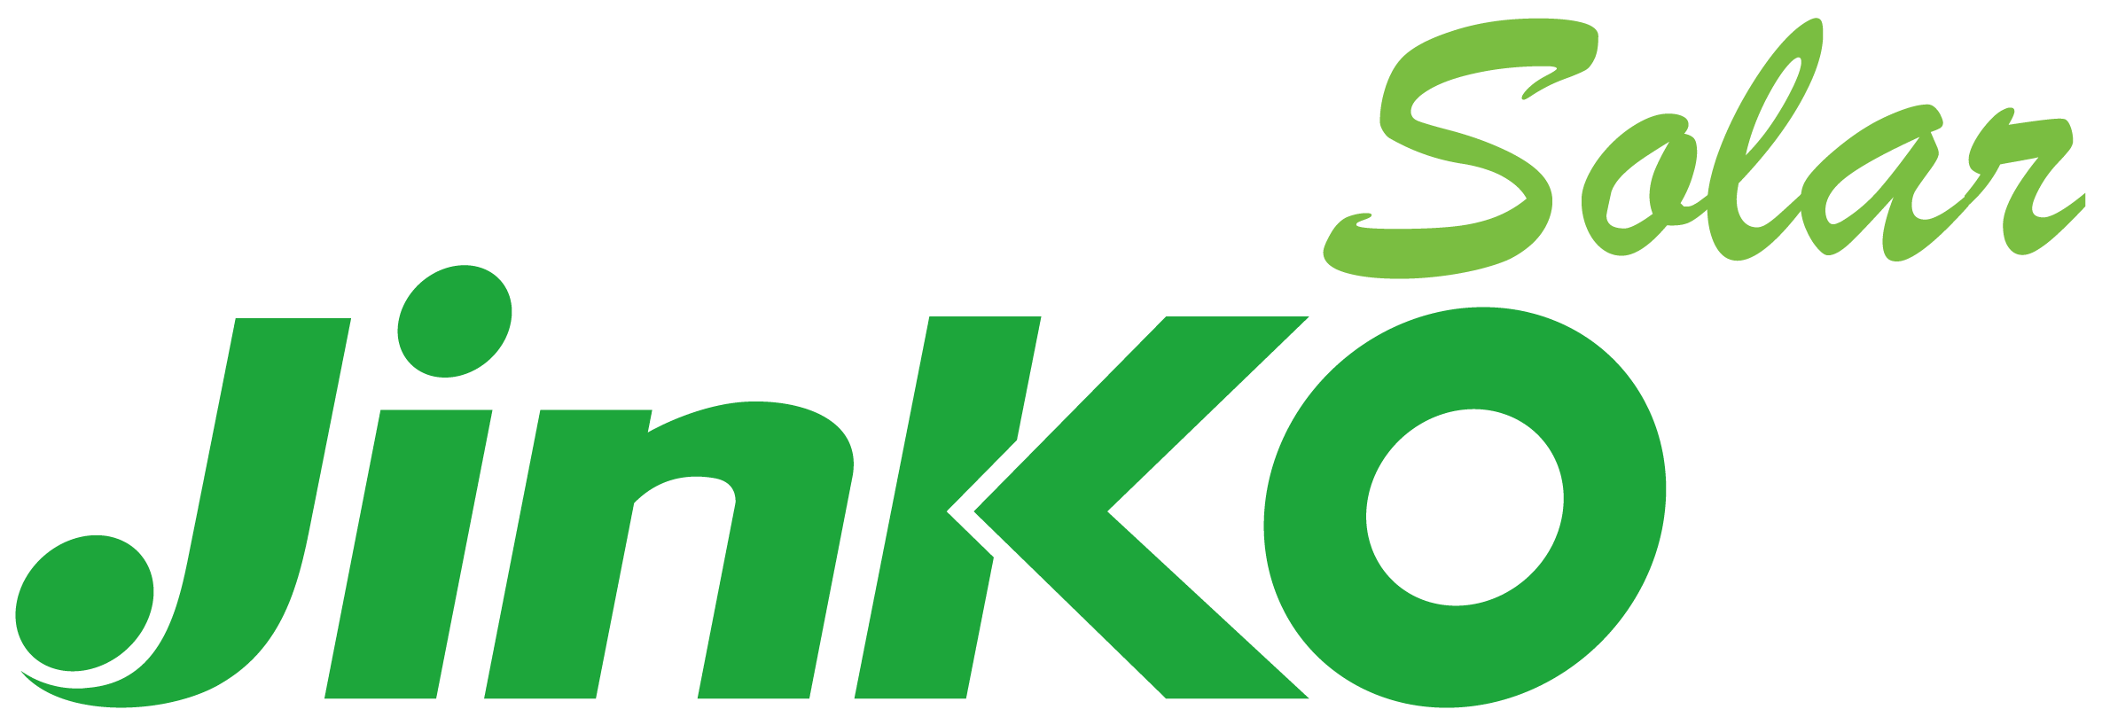
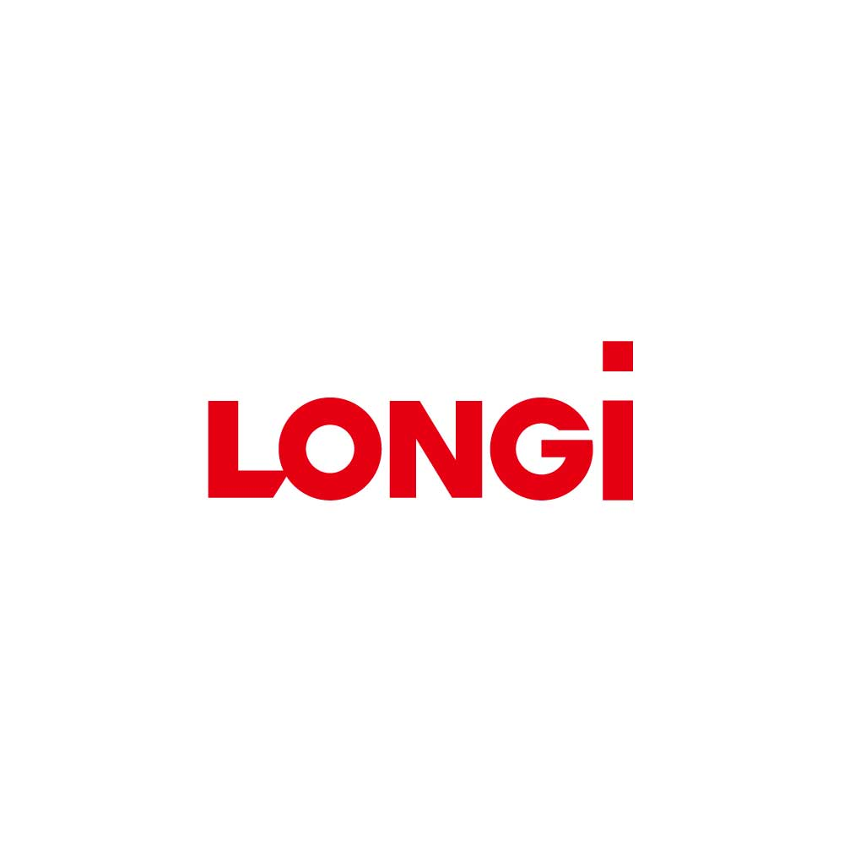
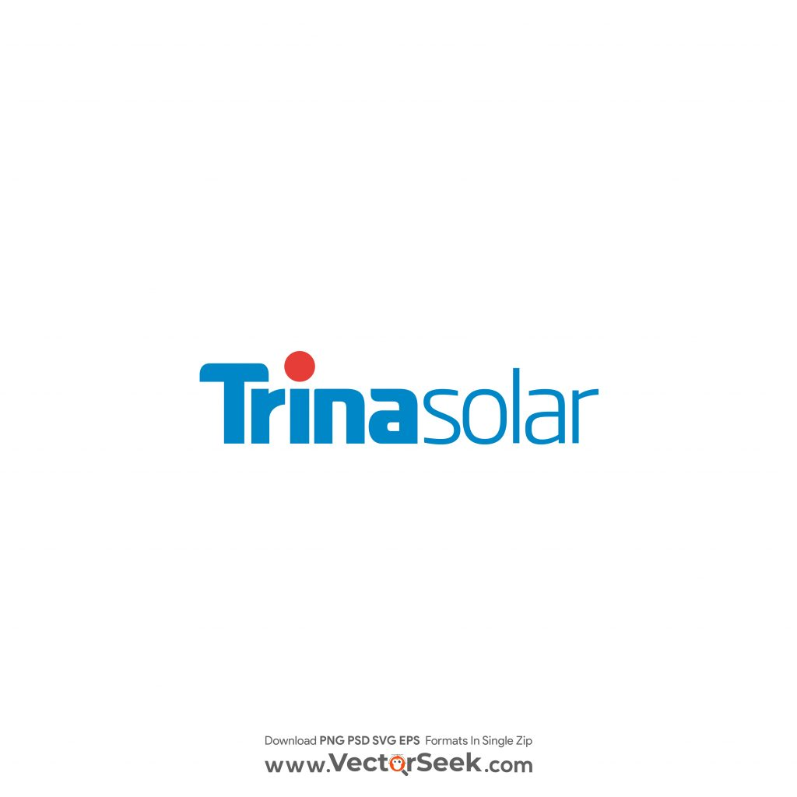

FSLR Story | Stock Performance Reflects Structural Advantages Over Global Competitors Across Technology, Supply Chain and Policy
Market Overview
First Solar Historic Stock Price ($)
280
Closing Price (20. Nov.): $245.9
Global polysilicon shortage benefit non-silicon FSLR
Q3 2021 Earnings Call reported an unexpected drop in revenues
Inflation Reduction Act ignite optimism in clean energy industry, FSLR acquire Evolar AB for photovoltaics, thin-film efficiency achievements
High treasury yields and high interest rates against inflation
Q1 2024 Earnings Call reported higher earnings than Q1 2023, gross profit margins increasing 37.3% YoY
Higher import competition, tariff uncertainty, and higher interest rates
IRA incentives, strong U.S. demand, expanded domestic manufacturing
260
1
240
4
5
6
2
220
7
3
200
180
3
160
4
140
1
2
120
5
100
80
6
60
2021
2022
2023
2024
2025
7
Competitor Analysis
Category | First Solar (FSLR) | Foreign Competitors
Technology | CdTe thin-film modules, high-temp & low-light efficiency, 4–8% higher real-world yield, lowest carbon footprint, fully US-based R&D | Crystalline silicon modules (mono-PERC/TOPCon), weaker real-world performance in heat, higher carbon intensity (~600–900 gCO₂e/Wp), R&D focused on incremental cell efficiency
Cost & Supply Chain | Fully vertically integrated (glass → semiconductor → module), avoids polysilicon price volatility, module cost ↓ ~35% since 2020, >90% materials recycled, $20B+ backlog | Dependent on global polysilicon & wafer supply, price volatility risk, heavily reliant on Chinese subsidies, exposure to US tariffs
Geographic & Policy | US-based (Ohio & Alabama), 100% IRA-compliant ($0.17/W tax credits), strong domestic sales (~80% in US), aligned with US reshoring | Majority of manufacturing in China, Malaysia, Vietnam, limited US IRA access, increasing regulatory headwinds
Financials | Gross margin ~37% FY 2024, strong cash position, long-term revenue visibility, capex offset by IRA credits | Gross margins ~20%, higher debt exposure, spot-market driven revenue, oversupply in China reduces module prices
Strategic Positioning | America’s solar champion, unique US product, structural moat from policy + technology + manufacturing | Strong global volumes, commoditized technology, increasing difficulty accessing US market
Source: https://investor.firstsolar.com/financials/quarterly-results/default.aspx. https://www.investopedia.com/news/solarcity-versus-first-solar-tsla-fslr/
Notes:
Stock History: focus 3 ↑
(political) Inflation Reduction Act optimism in clean E → fundamental market forces still present
(financial) favourable earnings report → superior tech allow ↑profit margin
Competitors:
Of the top 10 firms in the solar energy industry, how many based in China? 9 → where is the other 1? First Solar in US → not depend on silicon from China
Traditional polysilicon modules lose efficiency in heat (climate change) → ↓gross margins
ROE 17%
P/E 19x
EV/EBITDA 12.7x
Price-to-Sales 5.3x
Price-to-Book 2.8x

Slide 5


Industry Overview
Solar Energy Market | Structural Shifts in Electrification and Power Market Driving Sustained Industry Growth
Global Energy Trends
US Wholesale Power Market Opportunity
To-Do’s:
Check average selling price of modules
Highlight bold
Cut on bullets! To much text currently
Find more suitable logos
Structural shift towards electrification
Demand driven by Heating, Transport, Automation, and Data Centre demand. Forecasted Data Centre demand CAGR of 18% to 2030
Energy Security is a policy priority. Expand domestic generation, reduce fuel imports and supply chain risk
Solar LCOE has fallen rapidly and is now leading in the US
Global Solar PV rollout surged 85% and 33% in 2023 and 2024 respectively, with Asia-Pacific contributing 70% of this
IRA 45X and ITC create strong manufacturing + project-level incentives
Solar offers a premium return in wholesale markets, where marginal price is most often set by higher LCOE Gas-fired generators
7 Wholesale Markets and 3 Regions with fractured or vertically integrated regulated monopolies
Global oversupply from China/SEA but US regulatory barriers (FEOC, AD/CVD, Section 201, Section 232) protect domestic ASPs
Solar uptake fastest in competitive wholesale markets due to low LCOE
Structural shift towards competition and deregulation
New Frontiers
2026 expansion of CAISO day ahead market
Nevada transmission operators joining an RTO by 2030
North/South Carolina Gov examining RTO membership
ü
Global Solar CAGR
2014 – 2024: 27% 2025 – 2032 Forecast: 25%
Module Efficiency 2014-2024
c-Si 16% → 24% CdTe 9% → 20%
ü
ü
Why Solar … and Why CdTe?
US Gas Price Outlook
Total US Installed Solar Capacity
Fastest energy development time of any utility-scale technology.
Low operating cost – 0 Marginal Cost, centrally re-dispatched
NIMBYism reduced in comparison to wind
Silicone mono-crystalline (c-Si) modules comprise ~96% of global market
Thin-film, and particularly CdTe, is challenging this dominance:
Faster & simpler manufacturing, fewer inputs (1-2% semiconductor material): Deposit layer(s) of non-crystalline PV material onto substrate
Thin-film technologies include CdTe, CIGS, and Perovskite
Perovskite remains Nascent with stability issues, and GIGS has largely been outperformed by CdTe
CdTe is a mature technology in the US market, with a stable third of market share since 2010. First Solar is the CdTe industry leader
higher theoretical efficiency than single-junction silicon (32% vs 36%)
9
220
8
200
Henry Hub Natural Gas Price
($ per million BTU)
7
180
160
26% U.S. CAGR
6
140
5
GW
120
Utility
Scale
4
100
3
80
2
60
40
Residential
1
20
Industrial
0
2020
2021
2022
2023
2024
2025
2026
2027
0
2014
2015
2016
2017
2018
2019
2020
2021
2022
2023
2024
2025
Notes:
US Power Grid Notes: 7 competitive wholesale electricity markets (3 ISOs/ 4 RTOs) – Solar competitive with lowest LCOE. Three other regions (SE, NW, Mountain West): vertically integrated or fractured regulated monopolies relying on cost of service and return on Capital Expenditure, as well as bilateral PPAs.
Data Source: https://www.ise.fraunhofer.de/content/dam/ise/de/documents/publications/studies/Photovoltaics-Report.pdf
GICS: Copper Indium Gallium
Leading module efficiency: Si mono-crystalline (26), GICS (19.2), CdTe (19.9), Perovskite (19.2). Perovskite-Silicon Tandem (30.6), III-V/Si (33.7)
LID/LeTID: (Light Induced Degredation) and (Light and Elevated Temperature Induced Degradation) – specific to c-Si
US: 8.3% CAGR between 2024 and 2032 (https://www.gminsights.com/industry-analysis/solar-photovoltaic-pv-market?gad_source=1&gad_campaignid=21841935536&gbraid=0AAAAACuPGhX_t31tian1wvVsfloQtSxnB&gclid=CjwKCAiAz_DIBhBJEiwAVH2XwKdNSxvt6Kw28EDeofpt5Z4d19qMhLhJVO6L-AGqKeLFSZ39tAIqMhoCQgYQAvD_BwE)
Gas price forecast: increased liquefied natural gas (LNG) exports amid flat production growth
Reduced NIMBYism reduces the costs associated with finding a suitable location

Slide 6
Undisputed Domestic Leader | CdTe Delivers Superior Energy Yield & Integrated U.S. Supply Chain Enables a Structurally Lower Cost Per Watt
Technology + Vertical Integration = Structural Cost Advantage
Thesis 1
1
1. Technology Leadership: CdTe Solar Innovation
2. Cost Leadership: Vertical Integration & Efficiency
CdTe modules deliver ~6% higher energy yield vs. c-Si in hot, humid, and low-light conditions due to superior spectral response and a –0.28%/°C temperature coefficient
Thin-film CdTe architecture avoids silicon-specific failures (cell cracking, LID/LETID, micro-fractures), improving reliability in harsh climates
Lowest life-cycle emissions, water use, and energy-payback time in the industry, supporting adoption by utilities with ESG mandates and Scope 3 goals
0.3% p.a. degradation rate extends useful life by ~9 years relative to c-Si, reducing long-term LCOE for utility-scale assets
ESG advantage: ~90% material recovery and reusable packaging
Vertical integration shields FSLR from polysilicon price cycles, wafer shortages, SEA tariff risks (support stable COGS and higher throughput yields)
A single-location continuous-flow process (~4 hours) replaces the multi-stage, multi-country silicon chain, reducing logistics and quality-control costs
Proprietary CdTe vapor deposition, glass sourcing, and recycling have cut module cost per watt by ~35% since 2020, despite c-Si price volatility
Integrated operations support higher gross margins (≈40–55%) and stable ASPs (~$0.28–0.30/W), outperforming c-Si peers even in volatile markets
Margin resilience reflects technology differentiation and U.S. policy support, reinforcing strong pricing power
Raw Material
Thin-film Manufacturing
Module Assembly
Testing & Quality Control
Recycling & Reclaiming
Environmental Footprints of First Solar Compared to C-Si
Vertical integration delivers a structurally lower cost base and higher, more resilient margins through the cycle
3. Domestic Leadership: Scaled U.S. Manufacturing
FSLR is the only top-10 module producer outside China, with >14 GW U.S. capacity by 2026 from Ohio and Alabama expansions
U.S. footprint makes FSLR a preferred utility supplier amid tariff risk, procurement uncertainty, and stricter grid reliability standards
Fully FEOC-compliant operations secure IRA 45X + Domestic Content bonuses and meet future U.S. federal procurement rules
Perrysburg R&D campus (> $1bn) supports a roadmap toward 23–24% efficiency, reducing BOS and system-level costs
C-Si
First Solar Series 6
First Solar Series 7
CdTe’s superior yield, stability and footprint give FSLR a performance edge that silicon competitors cannot replicate
FSLR’s domestic scale and FEOC compliance uniquely position it as the preferred supplier in a tightening U.S. policy environment
Notes:
(+ive outlook for industry)
Tech: not all solar panels are the same → superior modules stand out when climate change → CdTe bandgap closer to solar spectrum optimum than silicon → ↑E yield in extreme conditions → Q what is preventing competitors from doing the same? FSLR has 326 active patents globally → secure tech
Sustainability: the env footprint of FSLR 4x < conventional silicon modules → env sustain = financial sustain → recycle 90% material save cost for premium margins (thesis 3)
Vertical integration: 2023 acquire Evolar thin-film photovoltaics → expand into R&D → enable future efficiency
Geopolitics: invest in new manufacturing plants in US (thesis 2)

Slide 7


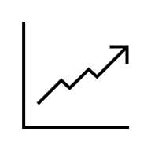
Structural Regulatory Moat | FEOC, IRA & U.S. Trade Enforcement Restrict Silicon Imports and Sustain FSLR’s Premium Pricing Power
Policy Moat Preserves Premium U.S. Pricing
Thesis 2
2
1. Tax Credits
4. Anti-dumping & Countervailing Duties (Pending)
FEOC: Foreign Entity of Concern
AD/CVD duties target Chinese and SE Asian silicon panels, raising import costs and offsetting subsidies
IRA: Section 48 Energy Investment Tax Credit
Consequences:
Competitors cannot undercut USA price. Sets a floor. Sustained pricing power
FSLR keeps ASPs high (~$0.28–$0.30/W) ²⁾ while global prices collapse (to ~$0.10-$0.15/W) ²⁾ from over-supply. FSLR sells at 2.5-3x global price. Higher Pricing Power
Gross margins stay elevated (40-55%) (see more in point 2)
Firm affiliated with governments of China, Russia, Iran, North Korea
FSLR is one of the only fully FEOC-clean US manufacturers, ensuring IRA eligibility
10% Domestic Content Bonus for US-made equipment (on top of the 30% Investment Tax Credit).
Only for projects that are entirely FEOC-free (FSLR, unlike silicon competitors)
FEOC rules + IRA create a structural, policy-driven advantage for First Solar vs. silicon importers
2. Production Credits
3. Tariffs for Competitors
IRA: Section 45X Advanced Manufacturing Production Credit
Trade Expansion Act: Section 232
Cambodia:
AD: 117%
CV: 534%
Vietnam:¹⁾
AD: 271%
CV: 125%
Thailand:
AD: 111%
CV: 264%
USA:
AD: 0%
CV: 0%
Shifting from SEA to US manufacturing earns a $0.07/W credit (~25% of ASP)
At 3.5GW output: ~$245M annual credits
Direct COGS reduction drives margin expansion from ~42% to ~55% (2025E–2028E)
Authorizes the U.S. President to impose tariffs or quotas on imports tied to national-security concerns, including solar supply chains
Introduces cost and policy uncertainty for foreign silicon-module producers.
Potential tariffs raise competitors’ landed costs, while FSLR remains unaffected due to its U.S.-based, FEOC-free supply chain
Drives U.S. buyers to favor domestic modules to avoid regulatory risk
Solar Module Price in US Market after AD & CVD ³⁾
High-visibility margin uplift independent of market pricing
Additional structural protection that hardens FSLR’s competitive position
Moat: Regulations effectively exclude low-cost silicon imports and preserve FSLR’s pricing power
Note: 1) FSLR does have some finishing-manufacturing steps in Vietnam, but AD/CVD not applicable, 2) Source: BofA (2025)
Source: 3) US Trade Government (2025)
Notes:
Point 1)
FEOC: Foreign Entity of Concern: Firm that is affiliated with governments of China, Russia, Iran, North Korea. If any part of supply chain touches a FEOC entity, firm loses federal bonus tax credits (these include 10% Domestic Content bonus ITC) (source: https://www.energy.gov/mesc/foreign-entity-concern-interpretive-guidance)
Anti-dumping Rules: trade penalties the US imposes when a foreign company sells products below fair market value (“dumping”) to undercut domestic manufacturers (← Note to self: Don’t have to explain what this is. Judges will know. ) FSLR unaffected by Anti-Dumping duties imposed on ultra-cheap Chinese crystalline silicon, whereas competitors’ costs rise. AD/CVD regulations set a floor for US module prices, to FSLR’s advantage. Far less downward pressure on US module prices. (source: https://www.trade.gov/press-release/us-department-commerce-announces-final-determinations-antidumping-and-countervailing)
NOTE: These are pending!! It all arose during an investigation in 2024/2025 against Chinese companies operating out of Cambodia, Malaysia, Thailand and Vietnam. That’s why the market has not priced them in yet, and hence the stock value will rise in the future
There are some other tariffs already in place on Chinese modules, which have been in place since the Obama administration. like:
AD duties: 30%-165% depending on company
CVD duties: 15%-50%
Some new tariffs were paused under the Biden administration, but considering the America-first mindset of Trump, it is very likely that new tariffs will be introduced
Statistics about AD/CVD for the four countries found here: https://www.projectfinance.law/publications/2025/april/updated-solar-import-tariffs.
https://www.trade.gov/preliminary-determinations-antidumping-duty-duty-investigations-crystalline-photovoltaic-cells
*FSLR does have some finishing-manufacturing steps in Vietnam, but only for front-end glass coating for their CdTe modules, not crystalline-silicon, which AD/CVD are targeted towards
Gross Margin = ( Total Revenue – COGS ) / Total Revenue
Section 232 Trade Expansion Act 1962: Allows President to impose tariffs when imports threaten national security. (source: https://www.bis.doc.gov/index.php/other-areas/office-of-technology-evaluation-ote/section-232-investigations)
Because FSLR sells at higher ASPs AND gets tax credits (like the 45X), their margins are structurally high.
AT THE END INCLUDE: Why the market has not priced this in yet. Because many of the policies (eg. The AD and CVD are pending, so the market has not priced them in yet)

Slide 8
Premium Margins + Visibility | A Contracted Backlog and rising U.S. Load Growth secure Demand, Pricing Stability and Cash Flow through 2030
Main Message: Backlog + U.S. Load Growth = Multi-Year Margin Expansion
Thesis 3
3
1. Backlog Secures Multi-Year Revenue & Pricing
2. US Load Growth Supports Capacity Expansion
FSLR’s contracted backlog totals 53.7 GW ($16.4bn) through 2030, insulating it from spot-market volatility and global silicon oversupply
U.S. factories are fully booked through 2028, ensuring fixed utilisation rates and predictable margin capture across the conversion cycle
The 79.2 GW pipeline (90%+ North America) gives optionality for repricing at higher ASPs as demand tightens and FEOC enforcement intensifies
5-year load growth forecast has increased by almost 5x, from 23 GW to 128 GW driven by data centres, electrification, AI and industrial reshoring
Data-centre-driven clusters (TX, VA, OH) increasingly require utility-scale solar to meet 24/7 load obligations, expanding contracted demand for domestic modules
U.S. capacity additions remain below required levels, keeping domestic module supply tight despite global oversupply
FSLR’s 3.7 GW U.S. expansion (2026–27) is fully FEOC-compliant and 45X-eligible, adding profitable volume in a structurally undersupplied market
Total Booking Opportunities (GW)
Contracted volumes secure utilisation and margins, giving FSLR unmatched earnings visibility into the next decade
5-year US Nationwide Growth Forecast
140
3. Shifting From Capex to Cash Generation
120
Heavy capex cycle is winding down, with 2025–28 growth funded largely via 45X credit monetisation and operating cash flow
Q3-25 results show a maturing financial profile (GM 38.3%, $456m net income) even before new capacity and full 45X capture
Transferability of tax credits (> $2bn monetised so far) accelerates FCF, reducing reliance on debt or equity financing
FCF ($Bn)
100
80
+228%
2029 Summer Peak Demand Growth (GW)
60
40
+70%
20
23A
24A
25E
26E
27E
28E
0
2022
2023
2024
FSLR is entering a high-margin, cash-generative phase with minimal financing needs and expanding free cash flow
Structural demand growth ensures domestic module supply remains tight, supporting continued ASP and share gains
Notes:
Thanks Fleur, I’ll now cover our third and final thesis, bringing the focus onto First Solar’s premium margins and their visibility of cash generation.
Firstly, First Solar has contracted backlog all the way through to 2030 and factories fully booked till 2028, guaranteeing multi-year revenue and pricing for them. Additionally, it has an upcoming contract pipeline of estimated $24 billion that is heavily US-focused.
Secondly, US nationwide energy load growth is forecasted to increase 5x by 2029, driven by data centres, AI and industrial reshoring. First Solar is able to fully capitalise on this opportunity by expanding their capacity through multiple new plants, which adds profitable volume in this undersupplied market.
Lastly, We believe First Solar is at this inflection point in its company life cycle, with heavy capex winding down and a shifting focus to cash generation. The latest earnings call has revealed a maturing financial profile as highlighted in the bottom left. We forecast First Solar’s FCF to accelerate, allowing us to take advantage of its entry into this high-margin, cash generative phase.

Slide 9



Valuation & Assumptions| DCF Points to Meaningful Upside Driven by ASP Strength and Volume Growth
Valuation
Scenario Analysis (FY25 – FY28)
Key Drivers: Skewed Towards Conservatism
FLSR maintains its ASP at $0.30 per W based on its domestic advantage and increased demand for power. Modules sold per year maintains at 38%, which matches current management forecasts as of 2025 (53.7GW backlog already in 2025). FSLR maintains its tax rate of 7.40% with rate increasing till 2028
FSLR maintains the ASP per W at $0.30. Modules sold growth rate flatlines at 35 Importantly, tax rate increases to 16% based on less advantageous tax breaks and credits
FSLR experiences a substantial increase in tax rate to 21%. This may be due to total change in the supporting tax credit structure for the green energy/solar industry ASPs fall below the US rate to $0.27
Case
Hist
Bear
Base
Bull
Sales CAGR
40.8%
30%
35%
38%
Revenue
COGS
%Rev.
44.7%
60%
50%
45%
Capex
Tax-Rate
7.4%
21%
16%
15%
Case comparison
Base Case
Bull Case
Bear Case
Tax
ASP Per W
$0.30
$0.27
$0.30
$0.30
2024A
2025E
2026E
2027E
2028E
Blended Target Price Scenario Analysis ($)
Target
Upside
Bear Case
148.40
-41.34%
2024A
2025E
2026E
2027E
2028E
Base Case
359.12
41.94%
Bull Case
457.20
80.71%
2024A
2025E
2026E
2027E
2028E
Notes: ASP sensitivity is based on 2028E projection using Base case scenarios. Exit multiple approach using a 9.0X multiple.
Source: ASP figures from BofA Global Research. Backlog figures from https://investor.firstsolar.com/financials/quarterly-results/default.aspx

Slide 10
Valuation & Sensitivity Analysis | Valuation Supported Across Sensitivities With Conservative Assumptions
Valuation
Sensitivity Analysis (Base Case)
WACC Calculation ($m)
1)
2)
1)
ASP Sensitivity Analysis (Exit Multiple Method - Base)
Industry WACC Comparisons
Share Price ($)
High - 17.8%
Analyst Industry Coverage 15/10/2025 – 12%
ASP ($/W)
Low - 10.8%
Note: 1) MV = Market Value, 2) FSLR has a uniquely low gross debt. This is due to cash generated by selling ITC (investment tax credits) to Visa, entering as cash flow.
Source: Beta: Yahoo finance 16/11/2025. US Corporate Tax Rate https://kpmg.com/dk/en/services/tax/corporate-tax/corporate-tax-rates-table.html. Debt Breakdown: BofA Global Research, CapIQ.
Candlestick: High :Gurufocus, Low: ValueSense. Mid: BofA Global Research.

Slide 11
Risks & Catalysts | High-Conviction Setup: Policy, Demand, and Technology Catalysts Ahead
Risks & Catalysts
Risks
Mitigants
Policy Exposure
Reliance on IRA 45X credits, Domestic Content rules and AD/CVD protections. A shift in U.S. trade or tax policy could weaken its cost advantage
Policy Durability
U.S.–China decoupling, national-security framing and bipartisan support for domestic clean-energy manufacturing make a reversal unlikely
!
ü
Demand and Project Timing
Utility-scale demand may slow due to interconnection bottlenecks. Trump presidency rolling back large-scale tax concessions for renewable projects
Structural Demand Drivers
Data-center load growth, electrification and declining interest rates support multi-year utility-scale procurement due to solar offering a lower LCOE, even without tax credits
!
ü
Technology Competitiveness
Rapid efficiency gains in TOPCon or heterojunction silicon could narrow First Solar’s real-world performance advantage
Strengthened CdTe Roadmap
First Solar’s R&D investments target >23% efficiency and maintain advantages in heat, low light and degradation that silicon cannot replicate
!
ü
Failure to Execute Roadmap
Scaling to ~25 GW capacity and improving Series 7 efficiency involves manufacturing, yield and supply chain risks
Proven Build-out and Multiple Cushions
Multiple successful factory ramps, a long-term, take-or-pay backlog, and low gearing (negative $1.8B net debt) provide execution cushion
!
ü
Events Path and Catalysts
1
2
3
Section 232 (2026 Q1):
The current active Section 232 into imports of polysilicon will conclude latest on 28 March 2026, drive increasing ASPs
Publication of FEOC (2026 Q2):
FEOC restricts the Chinese polysilicon supply chain and set to drive module ASPs higher, along other legislative dynamics to maintain ASPs at $0.30/W
Module Sold Ramping 45-50% (2025-2028):
FSLR increases its module sold volume by 45-50% from 2025-2028 delivering the current backlog, as executions hit and new production facilities ramp productions
Source: Section 232 investigation: Bureau of Industry and Security (2025); FEOC guideline: U.S. Department of Energy (2025); Roadmap and financials: FSLR 10Q (2025), CapIQ
Notes:
Munger once said, to succeed, you just have to avoid where it will fail. Luckily, in the case of first solar, our major risks are all well mitigated. The biggest risk of our thesis is the reliance on favourable regulatory policy. However, we see durability in current US trade policy amid the US-China decouping and solar being a strategic industry in this arm-race.
Demand
Additionally, the demand for utility-scale power may also slow due to the rolling back of tax-concessions for renewable projects under trump’s admin, deviating with our solar industry growth stack. But instead we see our structural demand drivers from for example Data centre remain resilient, due to the fact that solar offering a lower levelized cost of energy even absent tax credits
Tech and Management
There is also possibility that the rapid advancement poly-silicon tech could narrow first solar’s real world performance advanatage or management fail to execute roadmap on technology and capacity ramping, however, we see first solar having a strong technology differentiation and a great execution track record so far, even a miss in execution will be well buffered by its take-or-pay backlog, low gearing and policy position.
Catalysts
Moving on to catalysts, we break our catalyst to those tied to our key drivers of ASPs and capacity. For ASPs, two upcoming macro catalysts that are section 232 into polysilicon and FEOC which will exert upward pressure on ASP to at least maintain $0.30/w , which expected to be realised at Q1Q2 next year, and module sold we see execution to increase module sold by 45-50% by ramping production throughout 2025-2028, we will see the stock trends toward our target price when execution keep hitting and new facilities ramp their productions
That ll be the end of our presentation. Thank you for listening, and we now welcome any question

Slide 12
Thank You

Slide 13
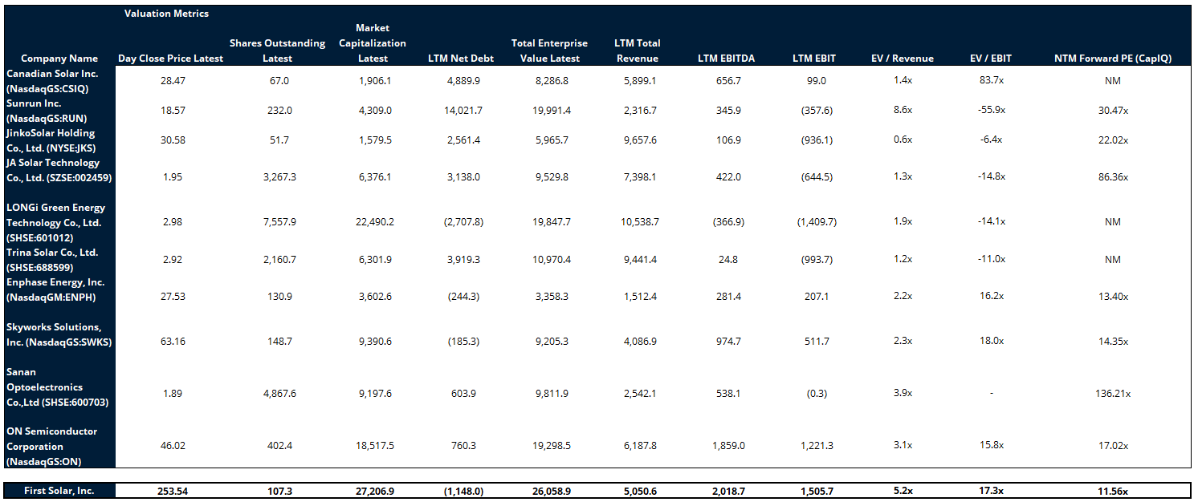
Appendix A | Public Comparable Analysis

Slide 14
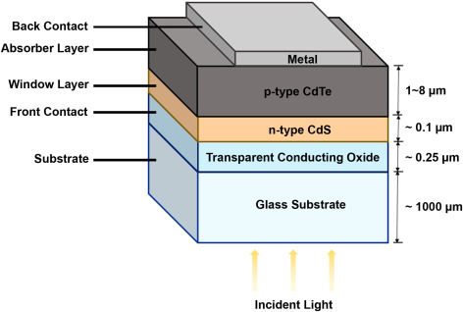
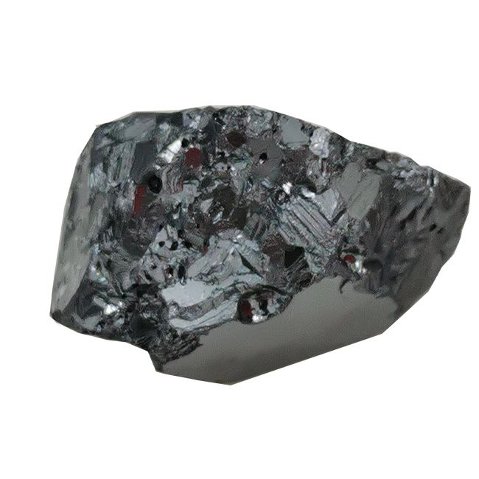

Appendix B | Cadmium Telluride (CdTe) Tech Advantage
Cadmium Telluride (CdTe) Panels
Material Sourcing
CdTe cells have a nearly ideal band gap of 1.44 eV.
Band gap determines the amount of energy that can be effectively converted into Electricity.
Direct band gap allows CdTe panels to be produced thinner, lowering production costs. 2-3 microns vs 150-200 microns.,
$500M invested in R&D by FSLR in solar tech like research into CdTe-perovskite panels in the Perrysburg, OH plant and other initiatives in the Jim Nolan Center in OH.
CdTe solar modules are made primarily from Cadmium and Tellurium, rare earth metals that are obtained as byproducts of the mining of other minerals
Though much of the world’s supply of these minerals is controlled by China, FSLR does not get the bulk of their supply from them, and is actively reducing their dependence on Chinese Te mines
CdTe Sustainability
Higher lifetime energy yield and less sensitive to weather
Not dependent on C-Si (reliant on China – UFLPA)
Lower CO2 and water footprint. Lasts 10 years longer than C-Si

Slide 15


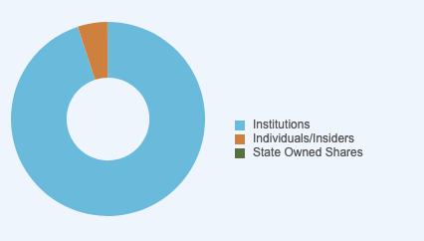
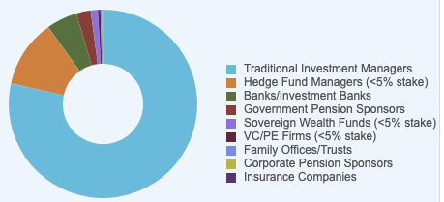

Appendix C | Leadership and Ownership
Leadership
Michael J. Ahearn
Non-Executive Chairman
Founder, FSLR
Co-founded the company
in 1999, CEO until 2009
ü
Long Term Commitment to FSLR
Long share holdings
ü
Ownership
Michael J. Ahearn
Non-Executive Chairman
Founder, FSLR
Co-founded the company
in 1999, CEO until 2009
Owns 81k shares
Alex Bradley
Chief Financial Officer
Part of Team since 2008
FSLR’s first internal CFO
after 8 years of work

Slide 16
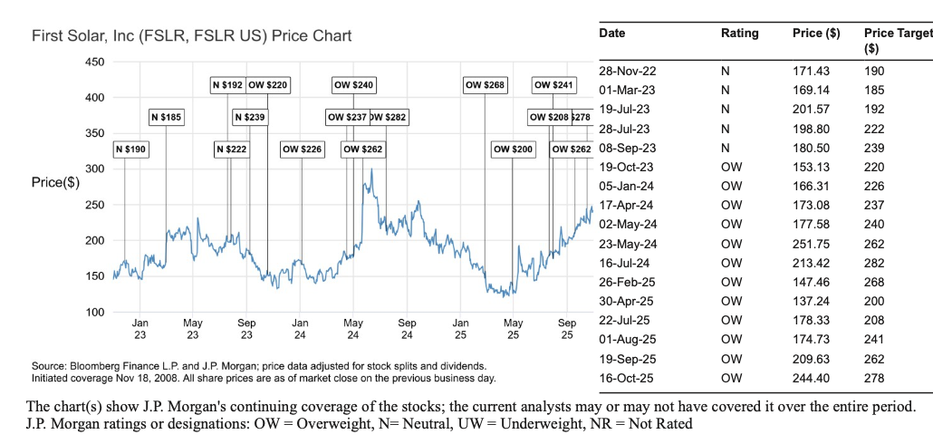
Appendix D | Analyst Price Targets
JPMC
Source:

Slide 17
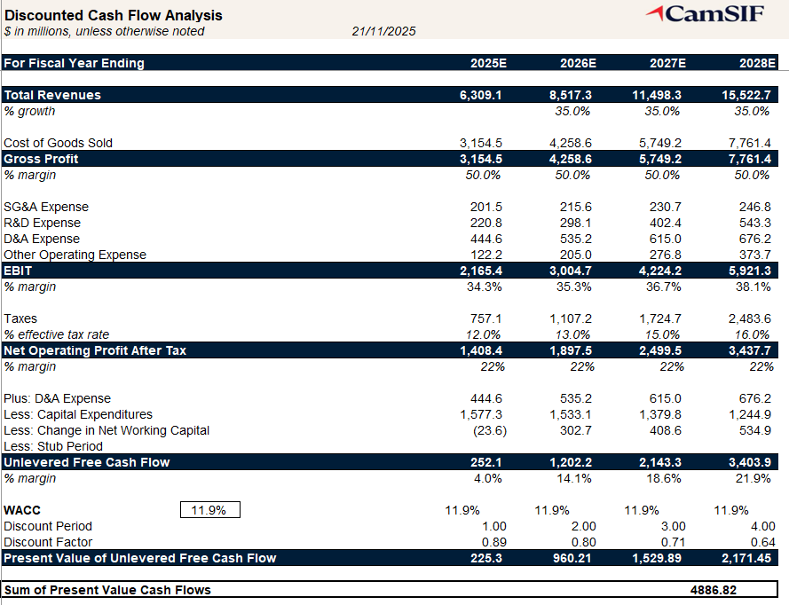
Appendix E | DCF Build - Base

Slide 18
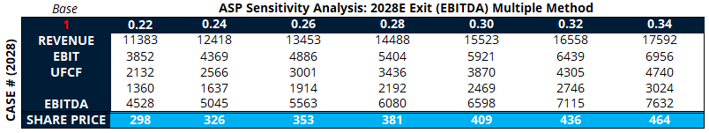
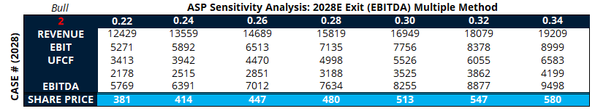
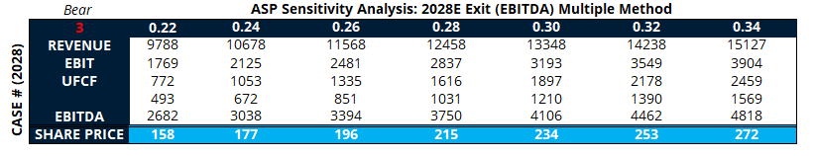
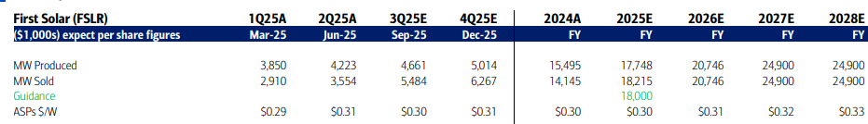
Appendix F | ASP Sensitivity (2028E)

Slide 19
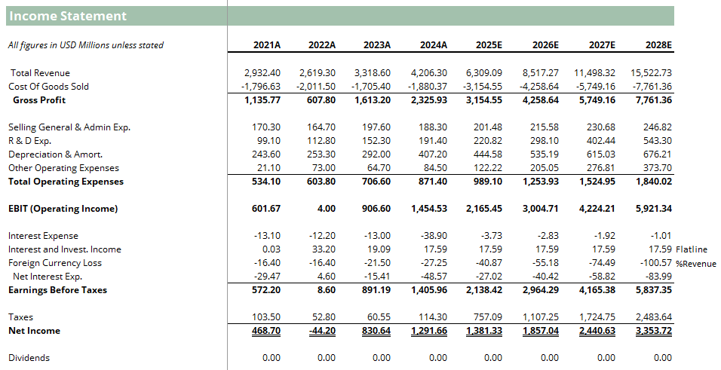
Appendix G | Income Statement Base

Slide 20
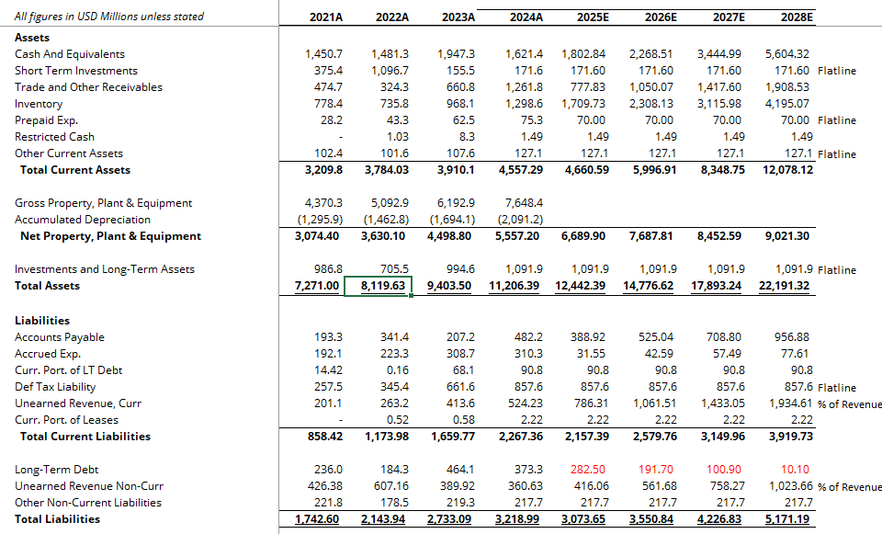
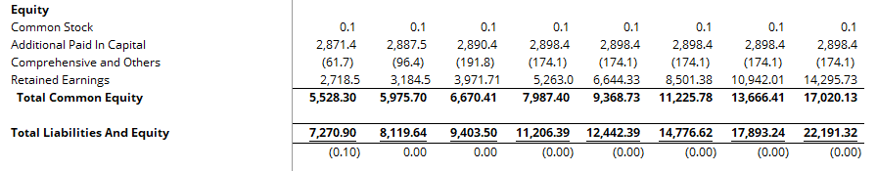
Appendix H | Balance Sheet Base

Slide 21
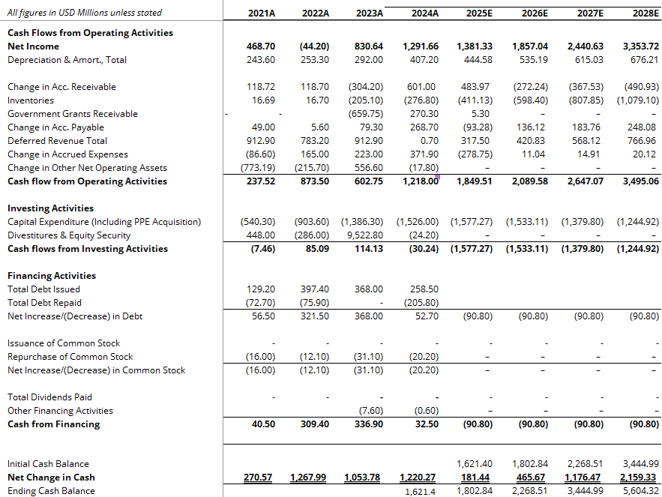
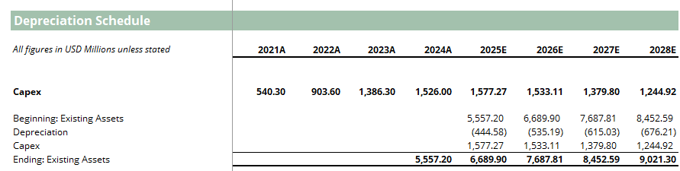
Appendix I | Cash Flow Base

Slide 22
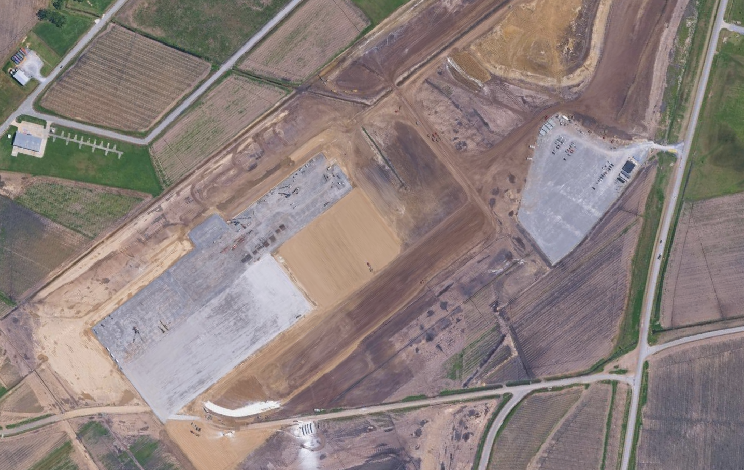
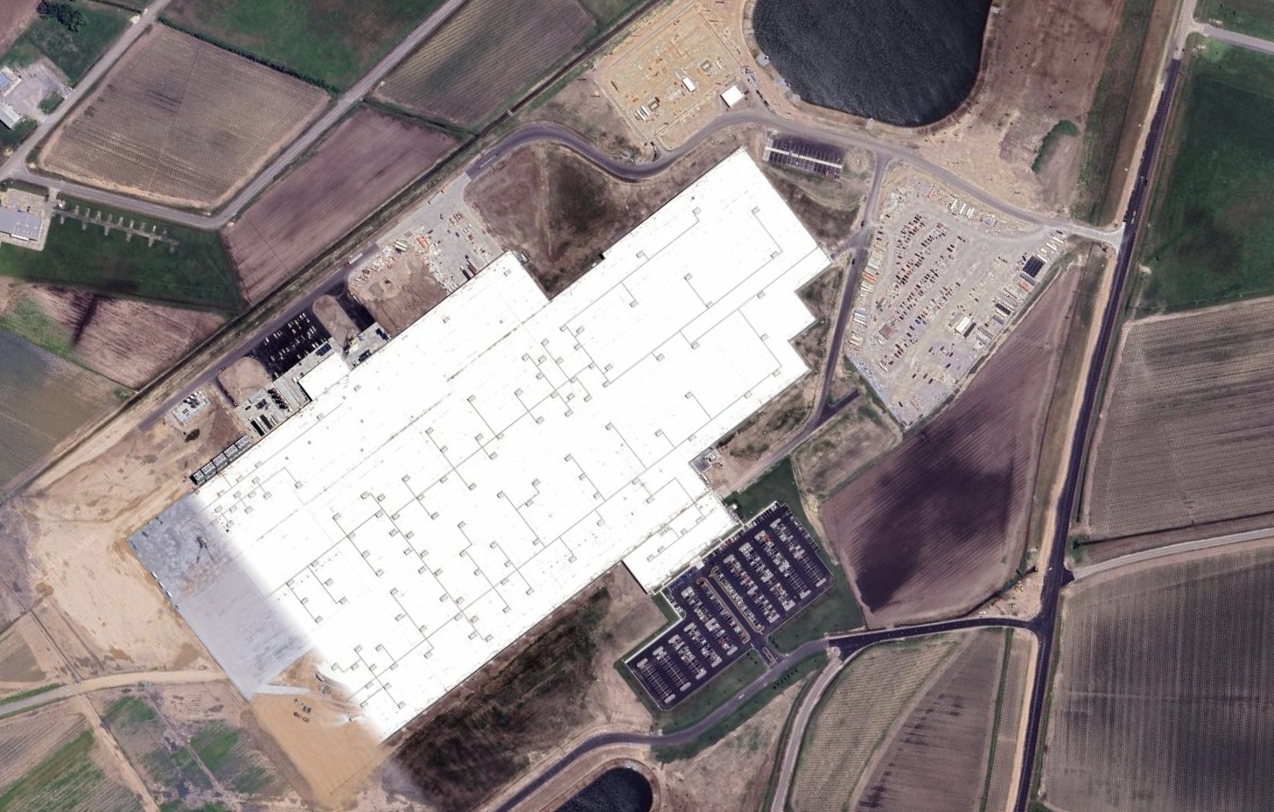
Appendix J | Satellite Map of Louisiana Facility Ramp Progress
Figure 1: Louisiana Facility at 19/3/2024
Figure 2: Louisiana Facility at 1/5/2025
Full roof coverage, structural construction complete, paving close to complete, a fit-out or pre-commissioning phase

Slide 23
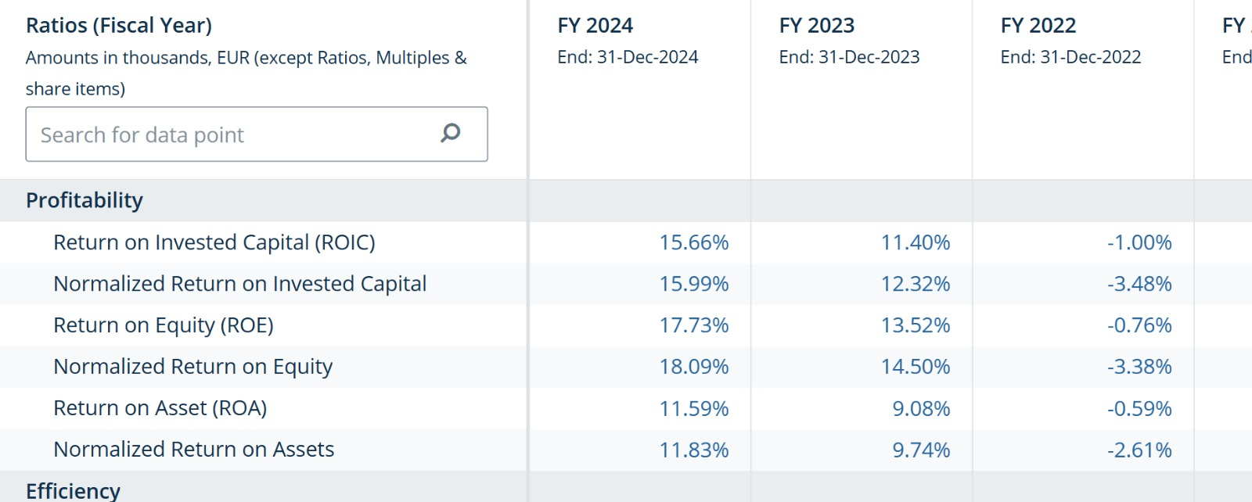
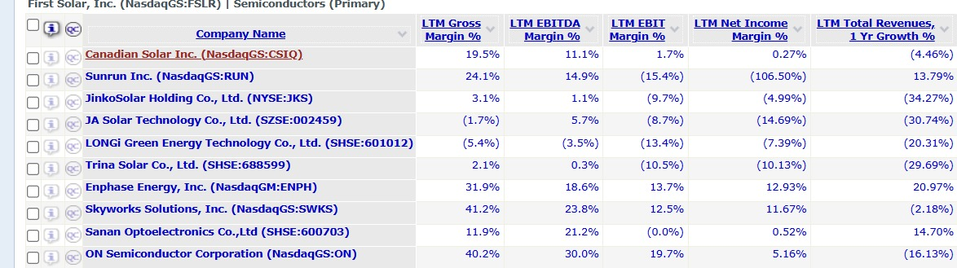
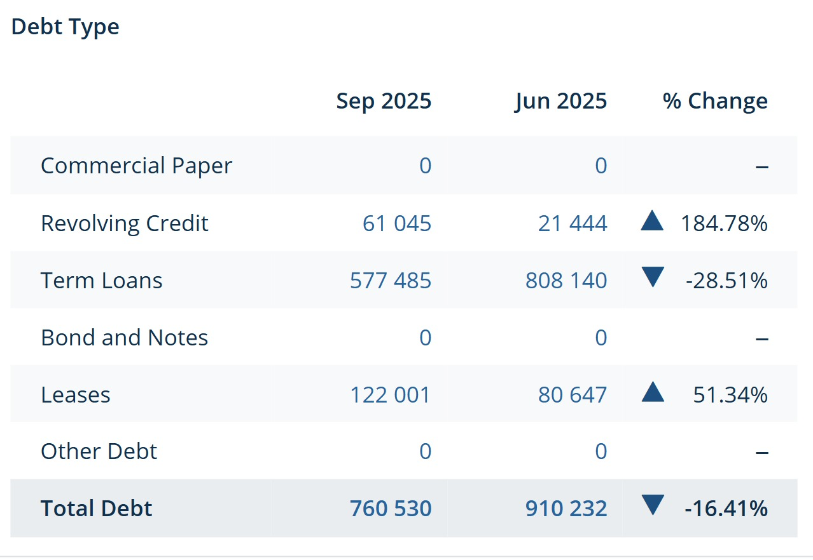
Appendix K | Ratios and Debt Structure

Slide 24
Archive

Slide 25
FIRST SOLAR (NASDAQ: FSLR)
Mias Updated Version
@General Final Checks:
Sources (financial reports)
Bold dark blue
Technology advantage mentioned multiple times
Show clear story line with upside potential from current stock price
Do more research on contracts (what more than backlog)
Investment activity (Evolar)
Delete dot after bullet
Add Appendix in similar formatting
Improve action titles
Clarify all units (in subtitles)
Potential questions:
Why capital structure no debt?
Why invest if stock price already this high?
What is the USP?
How is First Solar Stock price comparing to competitors stock price
Delete punctuation on bullets
Highlight important information bold (not too much)
Use dark blue bold and not black colour
Use black for normal text
Check if every slide has sources, if not add i.e. 2024 financial report
Check if all graphs have units
Capitalized letters in heading
Recommendation: LONG
Current Price: 245.84
Blended Target Price: 359.12 (41.94%)
Team Members: Alex Brown, Fleur Brinkmann, Junhao He, Joe Xu, Michael Kerins, Yifei Wang
IC: Mias Erni
November 22nd, 2025
25

Slide 26
Valuation & Assumptions| DCF Points to Meaningful Upside Driven by ASP Strength and Volume Growth
Valuation
Scenario Analysis (FY25 – FY28)
Key Drivers: Skewed Towards Conservatism (2028E)
FLSR maintains its ASP at $0.30 per W based on its domestic advantage and increased demand for power. Modules sold per year maintains at 38%, which matches current management forecasts as of 2025 (53.7GW backlog already in 2025). FSLR maintains its tax rate of 7.40% with rate increasing till 2028
FSLR maintains the ASP per W at $0.30. Modules sold growth rate flatlines at 35 Importantly, tax rate increases to 16% based on less advantageous tax breaks and credits
FSLR experiences a substantial increase in tax rate to 21%. This may be due to total change in the supporting tax credit structure for the green energy/solar industry ASPs fall below the US rate to $0.27
Case
Hist
Bear
Base
Bull
Sales CAGR
40.8%
30%
35%
38%
COGS
%Rev.
44.7%
60%
50%
45%
Tax-Rate
7.4%
21%
16%
15%
ASP Sensitivity Analysis (Exit Multiple Method - Base)
ASP Per W
$0.30
$0.27
$0.30
$0.30
Share Price ($)
Blended Target Price Scenario Analysis ($)
Target
Upside
Bear Case
148.40
-41.34%
Base Case
359.12
41.94%
ASP ($/W)
Bull Case
457.20
80.71%
Notes: ASP sensitivity is based on 2028E projection using Base case scenarios. Exit multiple approach using a 9.0X multiple.
Source: ASP figures from BofA Global Research. Backlog figures from https://investor.firstsolar.com/financials/quarterly-results/default.aspx

Slide 27
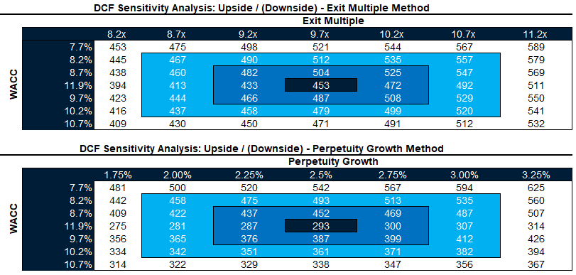
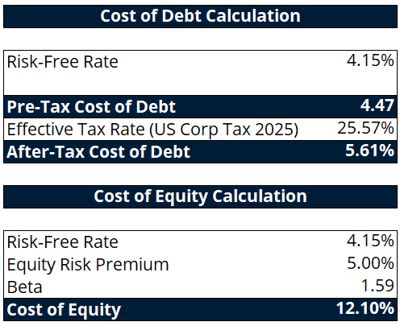
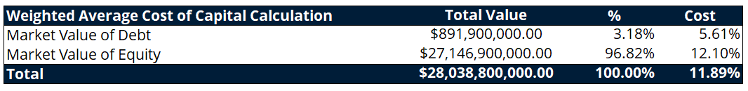
Valuation & Sensitivity Analysis | Valuation Supported Across Sensitivities With Conservative Assumptions
Valuation
Sensitivity Analysis
Cost of Debt Calculations
WACC Calculations
Industry WACC Comparisons
High - 17.8%
BofA Industry Coverage 15/10/2025 – 12%
FSLR has a uniquely low gross debt. This is due to cash generated by selling ITC (investment tax credits) to Visa, entering as cash flow.
Low - 10.8%
Source: Beta: Yahoo finance 16/11/2025. US Corporate Tax Rate https://kpmg.com/dk/en/services/tax/corporate-tax/corporate-tax-rates-table.html. Debt Breakdown: BofA Global Research, CapIQ.
Candlestick: High :Gurufocus, Low: ValueSense. Mid: BofA Global Research.

Slide 28









Mias Template
Template
Done
Action Title [Template Example]
Subtitle 1
Subtitle 1
Largest U.S. solar manufacturer focused on thin-film cadmium telluride (CdTe) modules, not dependent on polysilicon
Vertically integrated model across R&D, manufacturing, and recycling, giving strong cost and technology control
Products primarily sold to utility-scale solar developers (e.g., NextEra, Ørsted) under long-term multi-year supply contracts
….
Core markets:
Subtitle 1
Subtitle 1
Box type 1
ü
(£ in millions) | 9/28/2025
Share Price | 1.96
NOSH (M) | 9,779
Market Cap. | 19,700
Enterprise Value | 40,453
Box type 2
x
Box type 3
ü
Box type 4
Source:

Slide 29
Pitch Summary
Long First Solar | Policy-Protected Market Leader With Multi-Year Margin Expansion Still Underpriced
We propose a long position in First Solar (FSLR), supported by structural policy tailwinds, a durable technology moat, and multi-year margin expansion
First Solar is the leading U.S.-based solar manufacturer with a fully domestic, FEOC-compliant supply chain and differentiated CdTe thin-film technology
Despite strong historic share performance, we believe key catalysts remain underpriced, providing further upside potential from current share price of $245.9 (closing price 20.11.2025) to $359.1 by 2028 in our base case, representing a 41.9% upside
Narrative
Valuation and Price Target
Thesis 1
Undisputed Domestic Leader
Only large-scale US module manufacturer with fully compliant CdTe tech, insulated from polysilicon swings and China overcapacity
ü
1
Analysts project 22.8%–42.4% long-term growth (mean 32.6%) and a mean FY2025 price target of $274
FSLR trades at an earnings multiple that does not reflect its protected U.S. market position or multi-year margin expansion potential
With Series 7 ramp, 45X credit capture, and a >$20bn contracted backlog, earnings visibility is strong
Our valuation framework supports continued upside as regulatory catalysts crystallize and the efficiency roadmap delivers margin accretion
Thesis 2
Structural Regulatory Moat
FEOC¹⁾, AD/CVD²⁾, Section 232, and IRA³⁾ 45X credits all tighten the gate on imports while boosting FSLR’s unit economics. U.S. capacity is sold out through 2028
2
Thesis 3
Premium Margins + Visibility
ASPs firming, bookings accelerating (record 2.1 GW month). Gross margins moving toward 50–55 percent as U.S. finishing ramps and 45X credits scale
Valuation Football Field ($)
3
$325.3
Median
Current
valuation
Does it makes sense to include the share price analysis in the median for our case? We want to
Policy + Production Catalysts Ahead
Section 232 outcomes, FEOC restrictions, and a 45–50% module ramp through 2028 collectively reinforce higher U.S. ASPs, strengthen pricing power, and accelerate volume growth
$245.9
current
share price

Slide 30
Undisputed Domestic Leader | CdTe delivers superior energy yield and FSLR’s integrated U.S. supply chain enables a structurally lower cost per watt
Technology + Vertical Integration = Structural Cost Advantage
Thesis 1
1
1. Technology Leadership: CdTe Solar Innovation
2. Cost Leadership: Vertical Integration & Efficiency
CdTe modules deliver ~6% higher energy yield vs. c-Si in hot, humid, and low-light conditions due to superior spectral response and a –0.28%/°C temperature coefficient.
Thin-film CdTe architecture avoids silicon-specific failures (cell cracking, LID/LETID, micro-fractures), improving reliability in harsh climates.
Lowest life-cycle emissions, water use, and energy-payback time in the industry, supporting adoption by utilities with ESG mandates and Scope 3 goals.
0.3% annual degradation rate extends useful life by ~9 years relative to c-Si, reducing long-term LCOE for utility-scale assets.
ESG advantage: ~90% material recovery and reusable packaging.
Vertical integration shields FSLR from polysilicon price cycles, wafer shortages, SEA tariff risks (support stable COGS and higher throughput yields)
A single-location continuous-flow process (~4 hours) replaces the multi-stage, multi-country silicon chain, reducing logistics and quality-control costs.
Proprietary CdTe vapor deposition, glass sourcing, and recycling have cut module cost per watt by ~35% since 2020, despite c-Si price volatility.
Integrated operations support higher gross margins (≈40–55%) and stable ASPs (~$0.28–0.30/W), outperforming c-Si peers even in volatile markets.
Margin resilience reflects technology differentiation and U.S. policy support, reinforcing strong pricing power.
Raw Material
Thin-film Manufacturing
Module Assembly
Testing & Quality Control
Recycling & Reclaiming
Environmental Footprints of First Solar Compared to C-Si
Vertical integration delivers a structurally lower cost base and higher, more resilient margins through the cycle.
3. Domestic Leadership: Scaled U.S. Manufacturing
FSLR is the only top-10 module producer outside China, with >14 GW U.S. capacity by 2026 from Ohio and Alabama expansions.
U.S. footprint makes FSLR a preferred utility supplier amid tariff risk, procurement uncertainty, and stricter grid reliability standards.
Fully FEOC-compliant operations secure IRA 45X + Domestic Content bonuses and meet future U.S. federal procurement rules.
Perrysburg R&D campus (> $1bn) supports a roadmap toward 23–24% efficiency, reducing BOS and system-level costs.
C-Si
First Solar Series 6
First Solar Series 7
CdTe’s superior yield, stability and footprint give FSLR a performance edge that silicon competitors cannot replicate
FSLR’s domestic scale and FEOC compliance uniquely position it as the preferred supplier in a tightening U.S. policy environment

Slide 31
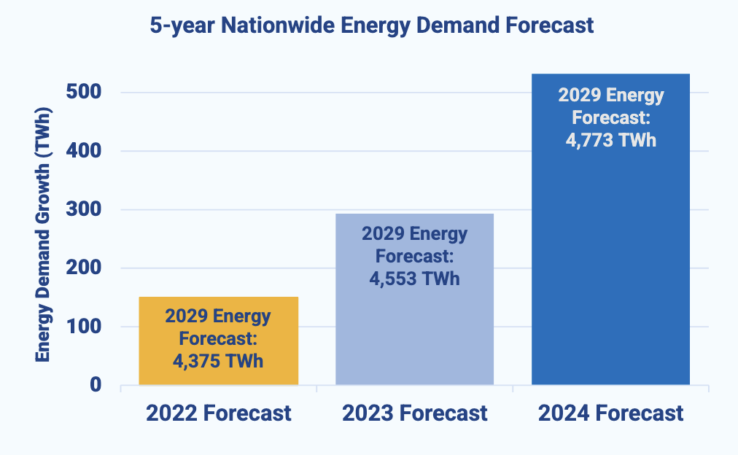
Premium Margins + Visibility | A contracted backlog and rising U.S. load growth secure throughput, pricing stability and cash generation through 2030
Main Message: Backlog + U.S. Load Growth = Multi-Year Margin Expansion
Thesis 3
Needs to be more targeted to First Solar
Question about graphics
3
1. Backlog Secures Multi-Year Revenue & Pricing
2. US Load Growth Supports Capacity Expansion
FSLR’s contracted backlog totals 53.7 GW ($16.4bn) through 2030, insulating it from spot-market volatility and global silicon oversupply
U.S. factories are fully booked through 2028, ensuring fixed utilisation rates and predictable margin capture across the conversion cycle
The 79.2 GW pipeline (90%+ North America) gives optionality for repricing at higher ASPs as demand tightens and FEOC enforcement intensifies
Multi-year take-or-pay structures reduce revenue volatility and ensure stable cash conversion even during policy or interest-rate fluctuations.
Updated 2024 forecasts raise U.S. 5-year demand growth from +3.6% to +12.5%, driven by data centres, electrification, AI and industrial reshoring
Data-centre-driven clusters (TX, VA, OH) increasingly require utility-scale solar to meet 24/7 load obligations, expanding contracted demand for domestic modules
U.S. capacity additions remain below required levels, keeping domestic module supply tight despite global oversupply
FSLR’s 3.7 GW U.S. expansion (2026–27) is fully FEOC-compliant and 45X-eligible, adding profitable volume in a structurally undersupplied market.
Total Booking Opportunities (GW)
Structural demand growth ensures domestic module supply remains tight, supporting continued ASP and share gains.
3. Shifting From Capex to Cash Generation
Heavy capex cycle is winding down, with 2025–2028 growth funded largely via 45X credit monetisation and operating cash flow.
Q3-25 results show a maturing financial profile (GM 38.3%, $456m net income) even before new capacity and full 45X capture
Transferability of tax credits (> $2bn monetised so far) accelerates free cash flow, reducing reliance on debt or equity financing
FSLR’s low net-debt position and expanding U.S. margin structure position it as a durable cash generator through the decade.
Mid-to-late Stage Opportunities (GW)
FCF ($Bn)
Contracted volumes secure utilisation and margins, giving FSLR unmatched earnings visibility into the next decade.
FSLR is entering a high-margin, cash-generative phase with minimal financing needs and expanding free cash flow.
2023A
2024A
2025E
2026E
2027E
2028E
Notes:
Soruces and further info:
Improved efficiency and margins: https://seekingalpha.com/article/4749404-first-solar-stock-strong-balance-sheet-with-minimal-debt
Forecasted demand for energy:
25Q3 earnings call and transcript: https://www.morningstar.com/stocks/xnas/fslr/earnings-transcripts

Slide 32
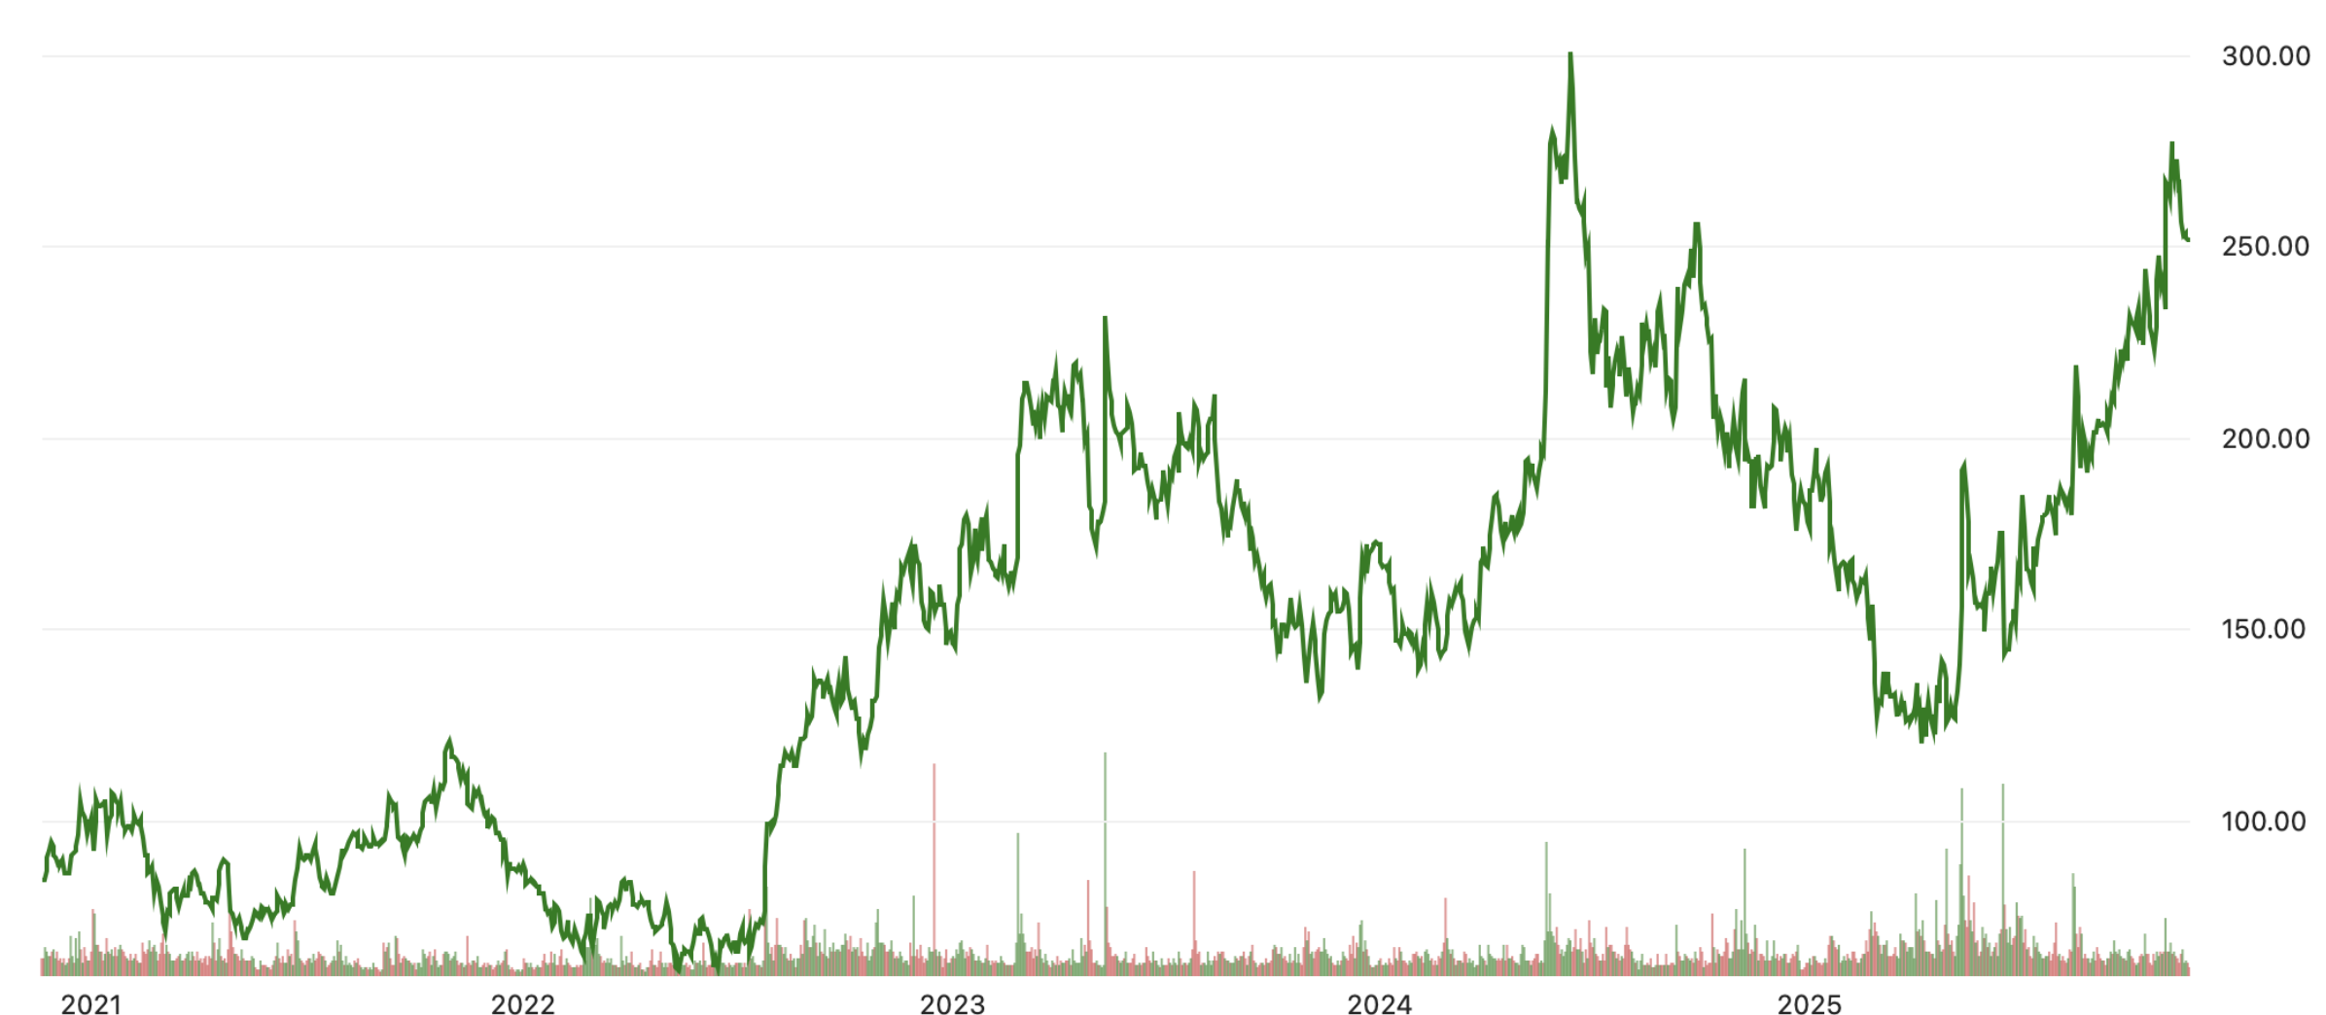
FSLR Story | Performance That Outshines Global Competitors
Market Overview
To-Do’s:
Include Logos in the competitors column
Indicate main historic catalyst for the stock chart
LTM Peer Stock Price Change
Global polysilicon shortage benefit non-silicon FSLR
Q3 2021 Earnings Call reported an unexpected drop in revenues
Inflation Reduction Act ignite optimism in clean energy industry, FSLR acquire Evolar for photovoltaics, thin-film efficiency achievements
High treasury yields and high interest rates against inflation
Q1 2024 Earnings Call reported higher earnings than Q1 2023, gross profit margins increasing 37.3& YoY
IRA incentives, strong U.S. demand, expanded domestic manufacturing
6
1
4
5
2
3
3
1
4
2
5
6
Category | First Solar (FSLR) | Foreign Competitors (Jinko, LONGi, Trina)
Technology | CdTe thin-film modules, high-temp & low-light efficiency, 4–8% higher real-world yield, lowest carbon footprint, fully US-based R&D | Crystalline silicon modules (mono-PERC/TOPCon), weaker real-world performance in heat, higher carbon intensity (~600–900 gCO₂e/Wp), R&D focused on incremental cell efficiency
Cost & Supply Chain | Fully vertically integrated (glass → semiconductor → module), avoids polysilicon price volatility, module cost ↓ ~35% since 2020, >90% materials recycled, $20B+ backlog | Dependent on global polysilicon & wafer supply, price volatility risk, heavily reliant on Chinese subsidies, exposure to US tariffs
Geographic & Policy | US-based (Ohio & Alabama), 100% IRA-compliant ($0.17/W tax credits), strong domestic sales (~80% in US), aligned with US reshoring | Majority of manufacturing in China, Malaysia, Vietnam, limited US IRA access, increasing regulatory headwinds
Financials | Gross margin ~37% FY 2024, strong cash position, long-term revenue visibility, capex offset by IRA credits | Gross margins ~20%, higher debt exposure, spot-market driven revenue, oversupply in China reduces module prices
Strategic Positioning | America’s solar champion, unique US product, structural moat from policy + technology + manufacturing | Strong global volumes, commoditized technology, increasing difficulty accessing US market
Notes:
Source:

Slide 33
Premium Margins + Visibility | A contracted backlog and rising U.S. load growth secure demand, pricing stability and cash flow through 2030
Main Message: Backlog + U.S. Load Growth = Multi-Year Margin Expansion
Thesis 3
3
1. Backlog Secures Multi-Year Revenue & Pricing
2. US Load Growth Supports Capacity Expansion
FSLR’s contracted backlog totals 53.7 GW ($16.4bn) through 2030, insulating it from spot-market volatility and global silicon oversupply
U.S. factories are fully booked through 2028, ensuring fixed utilisation rates and predictable margin capture across the conversion cycle
The 79.2 GW pipeline (90%+ North America) gives optionality for repricing at higher ASPs as demand tightens and FEOC enforcement intensifies
5-year load growth forecast has increased by almost 5x, from 23 GW to 128 GW driven by data centres, electrification, AI and industrial reshoring
Data-centre-driven clusters (TX, VA, OH) increasingly require utility-scale solar to meet 24/7 load obligations, expanding contracted demand for domestic modules
U.S. capacity additions remain below required levels, keeping domestic module supply tight despite global oversupply
FSLR’s 3.7 GW U.S. expansion (2026–27) is fully FEOC-compliant and 45X-eligible, adding profitable volume in a structurally undersupplied market.
Total Booking Opportunities (GW)
Contracted volumes secure utilisation and margins, giving FSLR unmatched earnings visibility into the next decade
2029 US Nationwide Growth Forecast
3. Shifting From Capex to Cash Generation
Heavy capex cycle is winding down, with 2025–2028 growth funded largely via 45X credit monetisation and operating cash flow.
Q3-25 results show a maturing financial profile (GM 38.3%, $456m net income) even before new capacity and full 45X capture
Transferability of tax credits (> $2bn monetised so far) accelerates free cash flow, reducing reliance on debt or equity financing
FCF ($Bn)
2029 Summer Peak Demand Growth (GW)
+228%
+70%
2023A
2024A
2025E
2026E
2027E
2028E
2022
2023
2024
FSLR is entering a high-margin, cash-generative phase with minimal financing needs and expanding free cash flow.
Structural demand growth ensures domestic module supply remains tight, supporting continued ASP and share gains.
Notes:
Soruces and further info:
Improved efficiency and margins: https://seekingalpha.com/article/4749404-first-solar-stock-strong-balance-sheet-with-minimal-debt
Forecasted demand for energy:
25Q3 earnings call and transcript: https://www.morningstar.com/stocks/xnas/fslr/earnings-transcripts

Slide 34
Industry Overview
Solar Energy Market | Structural Shifts in Electrification and Power Market Driving Sustained Industry Growth
Global Energy Trends
US Wholesale Power Market Opportunity
To-Do’s:
Check average selling price of modules
Highlight bold
Cut on bullets! To much text currently
Find more suitable logos
Structural shift towards electrification.
Demand driven by Heating, Transport, Automation, and Data Centre demand. Forecasted Data Centre demand CAGR of 18% to 2030.
Energy Security is a policy priority. Expand domestic generation, reduce fuel imports and supply chain risk.
Solar LCOE has fallen rapidly and is now leading in the US.
Global Solar PV rollout surged 85% and 33% in 2023 and 2024 respectively, with Asia-Pacific contributing 70% of this.
IRA 45X and ITC create strong manufacturing + project-level incentives.
Solar offers a premium return in wholesale markets, where marginal price is most often set by higher LCOE Gas-fired generators
7 Wholesale Markets and 3 Regions with fractured or vertically integrated regulated monopolies
Global oversupply from China/SEA but US regulatory barriers (FEOC, AD/CVD, Section 201, Section 232) protect domestic ASPs.
Solar uptake fastest in competitive wholesale markets due to low LCOE
Structural shift towards competition and deregulation
New Frontiers
2026 expansion of CAISO day ahead market
Nevada transmission operators joining an RTO by 2030
North/South Carolina Gov examining RTO membership
Global Solar CAGR
2014 – 2024: 27% 2025 – 2032 Forecast: 25%
Module Efficiency 2014-2024
c-Si 16% → 24% CdTe 9% → 20%
US Gas Price Outlook
Total US Installed Solar Capacity
Why Solar … and Why CdTe?
220
9
Fastest energy development time of any utility-scale technology.
Low operating cost – 0 Marginal Cost, centrally re-dispatched
NIMBYism reduced in comparison to wind
Silicone mono-crystalline (c-Si) modules comprise ~96% of global market
Thin-film, and particularly CdTe, is challenging this dominance:
Faster & simpler manufacturing, fewer inputs (1-2% semiconductor material): Deposit layer(s) of non-crystalline PV material onto substrate.
Thin-film technologies include CdTe, CIGS, and Perovskite
Perovskite remains Nascent with stability issues, and GIGS has largely been outperformed by CdTe
CdTe is a mature technology in the US market, with a stable third of market share since 2010. First Solar is the CdTe industry leader.
higher theoretical efficiency than single-junction silicon (32% vs 36%)
Henry Hub Natural Gas Price
($ per million BTU)
8
200
26% U.S. CAGR
7
180
6
160
5
140
4
GW
120
Utility
Scale
3
100
2
80
1
60
0
40
Residential
Jan 2020
Jan 2021
Jan 2022
Jan 2023
Jan 2024
Jan 2025
Jan 2026
Jan 2027
20
Industrial
0
2014
2015
2016
2017
2018
2019
2020
2021
2022
2023
2024
2025
Notes:
US Power Grid Notes: 7 competitive wholesale electricity markets (3 ISOs/ 4 RTOs) – Solar competitive with lowest LCOE. Three other regions (SE, NW, Mountain West): vertically integrated or fractured regulated monopolies relying on cost of service and return on Capital Expenditure, as well as bilateral PPAs.
Data Source: https://www.ise.fraunhofer.de/content/dam/ise/de/documents/publications/studies/Photovoltaics-Report.pdf
GICS: Copper Indium Gallium
Leading module efficiency: Si mono-crystalline (26), GICS (19.2), CdTe (19.9), Perovskite (19.2). Perovskite-Silicon Tandem (30.6), III-V/Si (33.7)
LID/LeTID: (Light Induced Degredation) and (Light and Elevated Temperature Induced Degradation) – specific to c-Si
US: 8.3% CAGR between 2024 and 2032 (https://www.gminsights.com/industry-analysis/solar-photovoltaic-pv-market?gad_source=1&gad_campaignid=21841935536&gbraid=0AAAAACuPGhX_t31tian1wvVsfloQtSxnB&gclid=CjwKCAiAz_DIBhBJEiwAVH2XwKdNSxvt6Kw28EDeofpt5Z4d19qMhLhJVO6L-AGqKeLFSZ39tAIqMhoCQgYQAvD_BwE)
Gas price forecast: increased liquefied natural gas (LNG) exports amid flat production growth
Reduced NIMBYism reduces the costs associated with finding a suitable location

